Slide 1
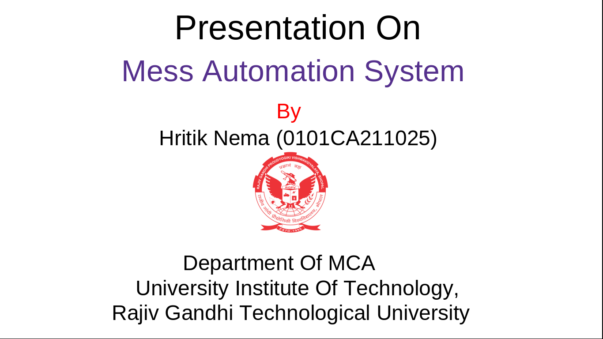

Presentation On Mess Automation System
By
Hritik Nema (0101CA211025)
Department Of MCA
University Institute Of Technology,
Rajiv Gandhi Technological University

Slide 2
Introduction and Recap
GUI
Technical Description
E-R Diagram
Limitations & Future Scope
Conclusion

Slide 3
Introduction and Recap

Slide 4
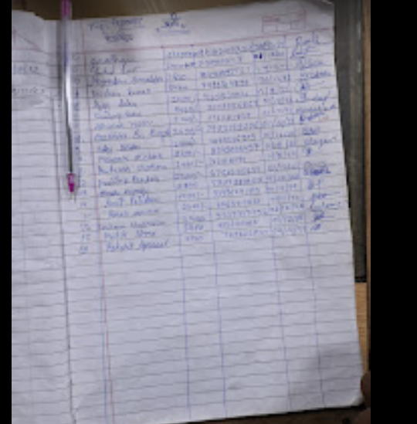
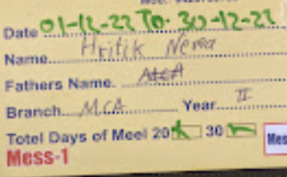

Slide 5
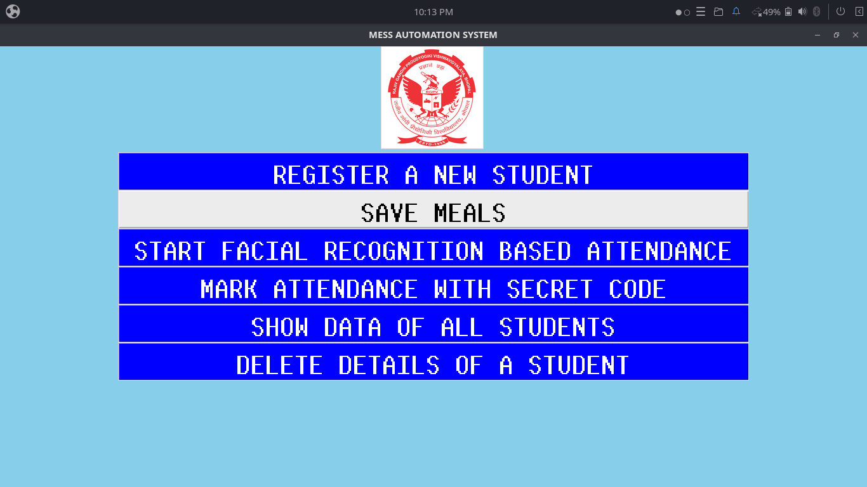

Slide 6
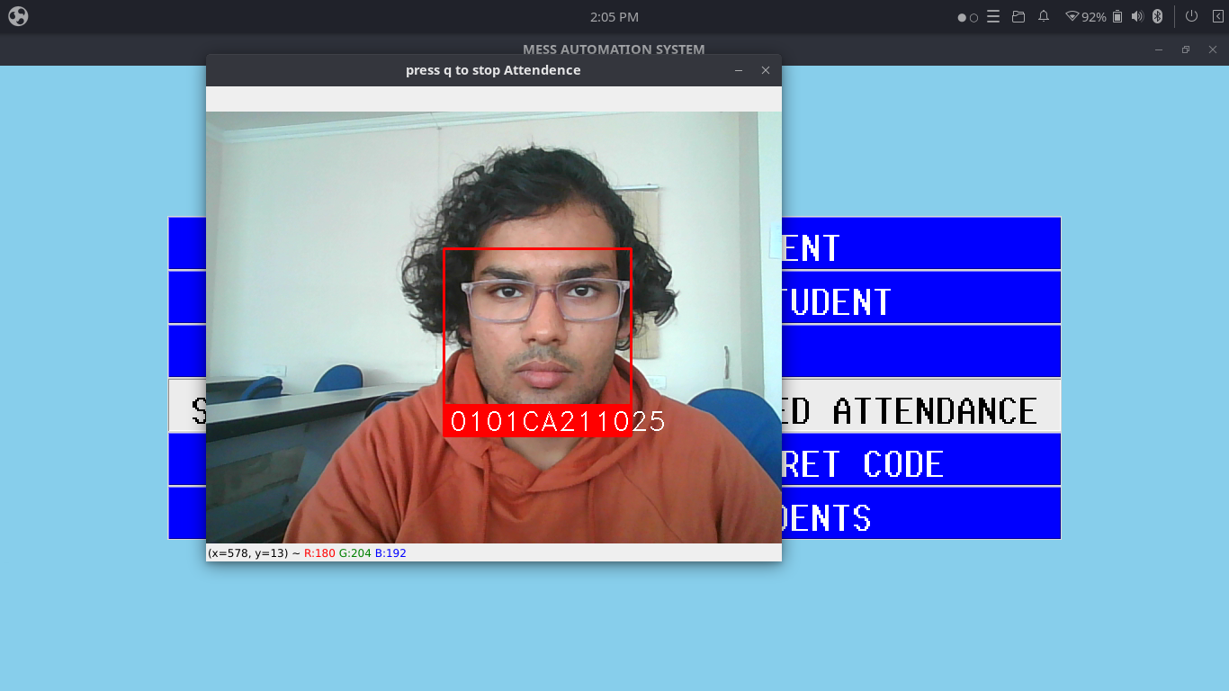

Slide 7
QR Code > Facial Recognition

Slide 8
GUI

Slide 9
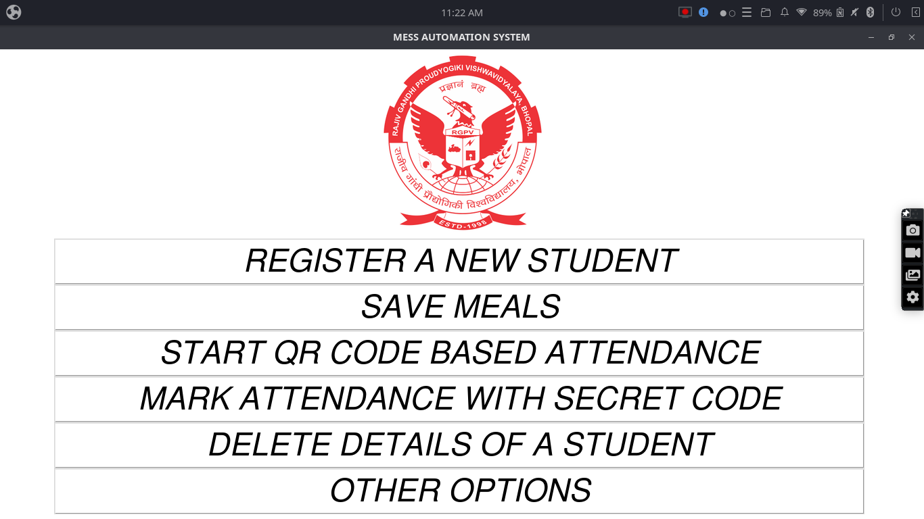

Slide 10
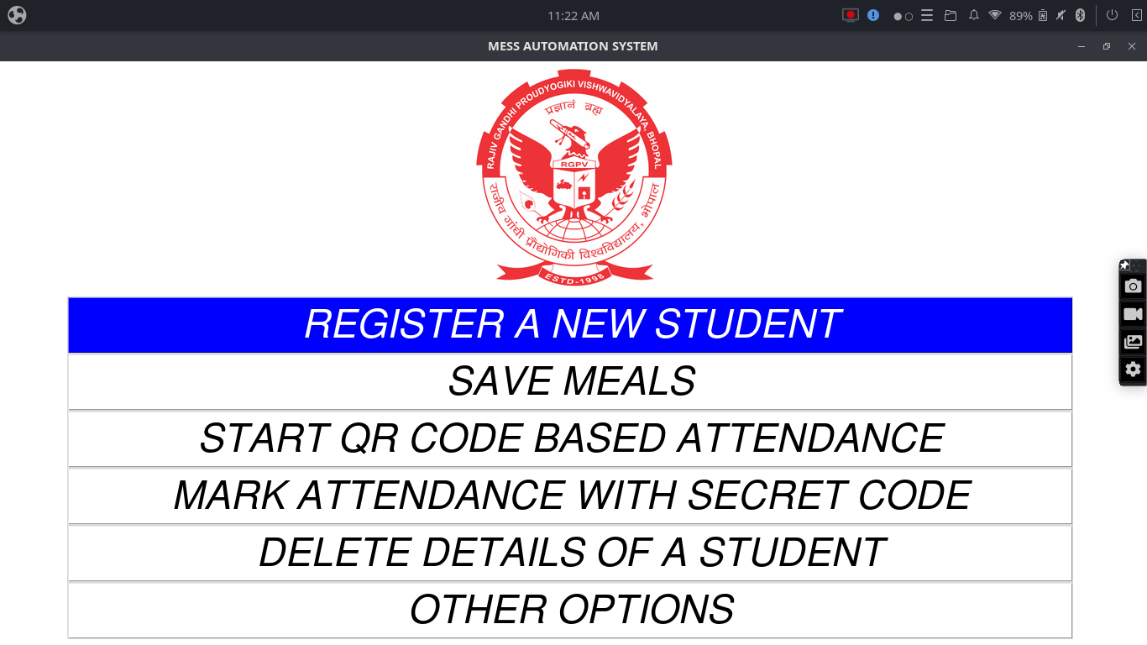

Slide 11
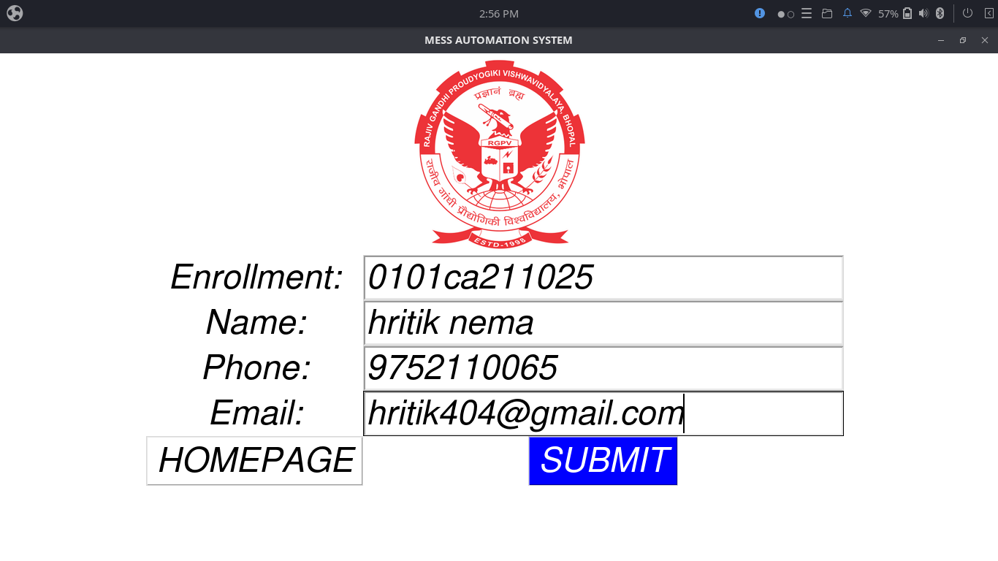

Slide 12
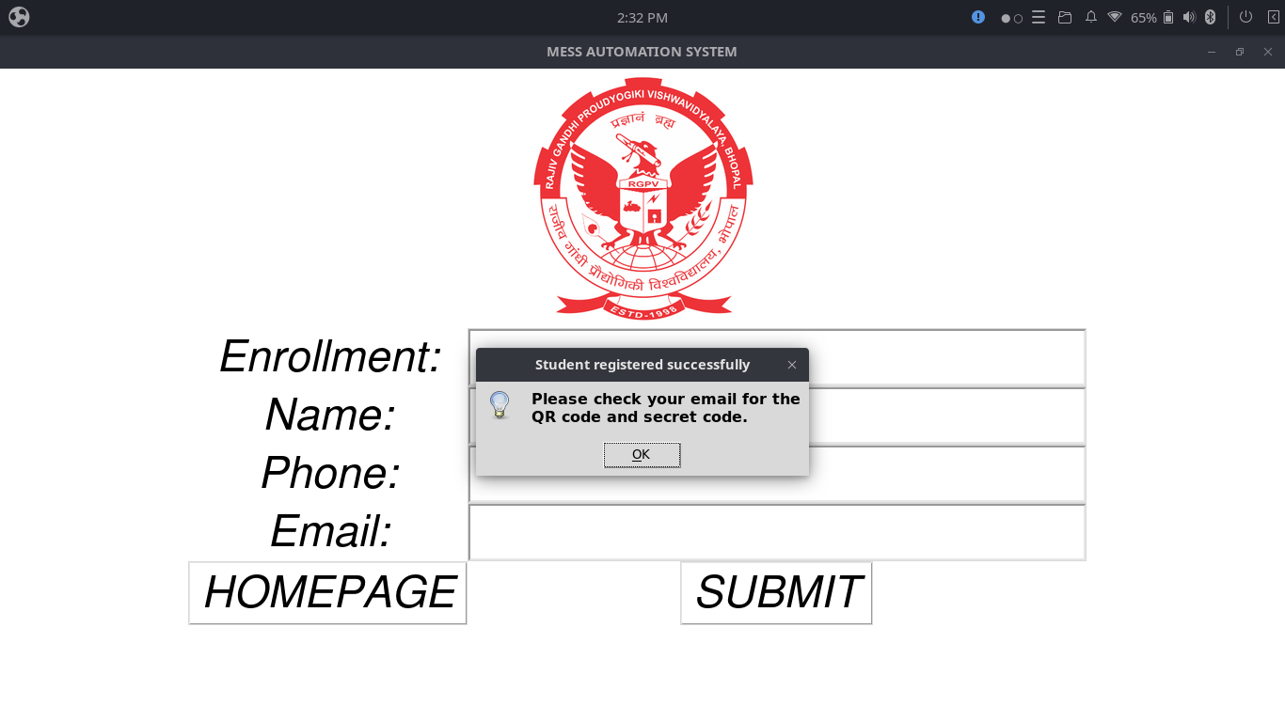

Slide 13
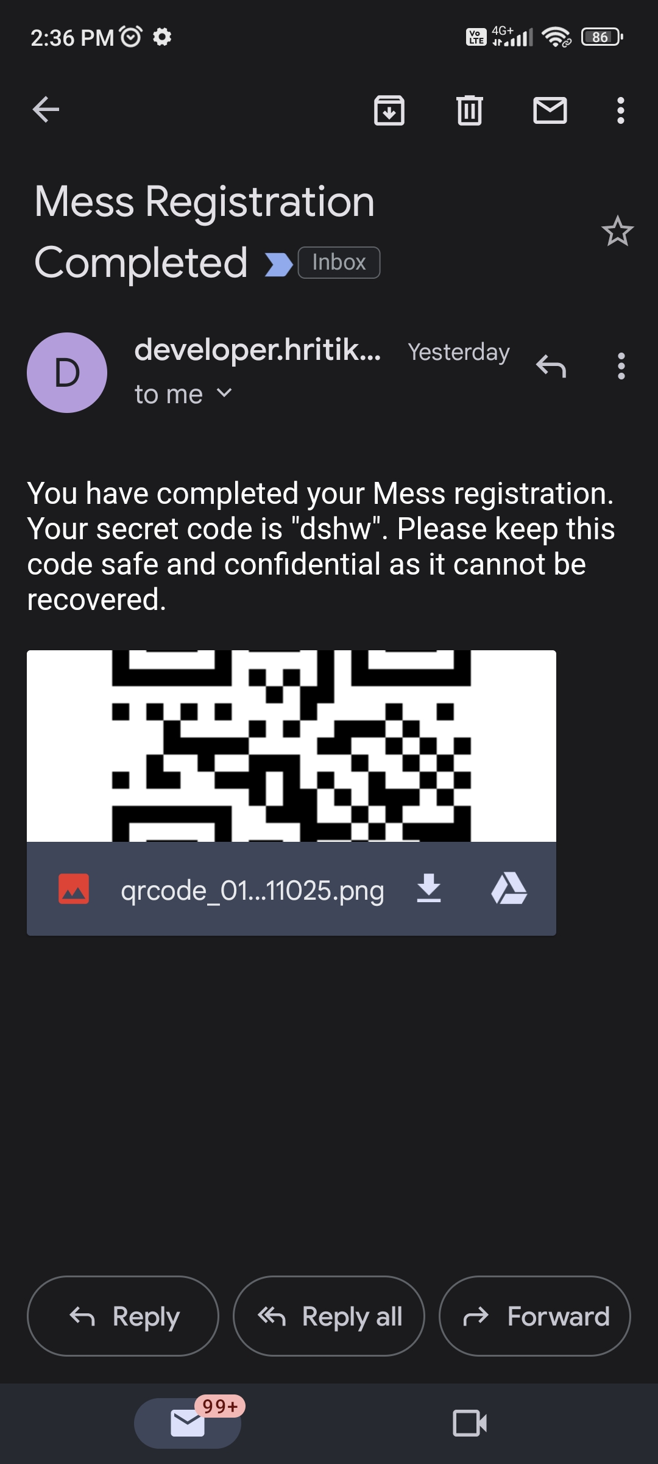

Slide 14
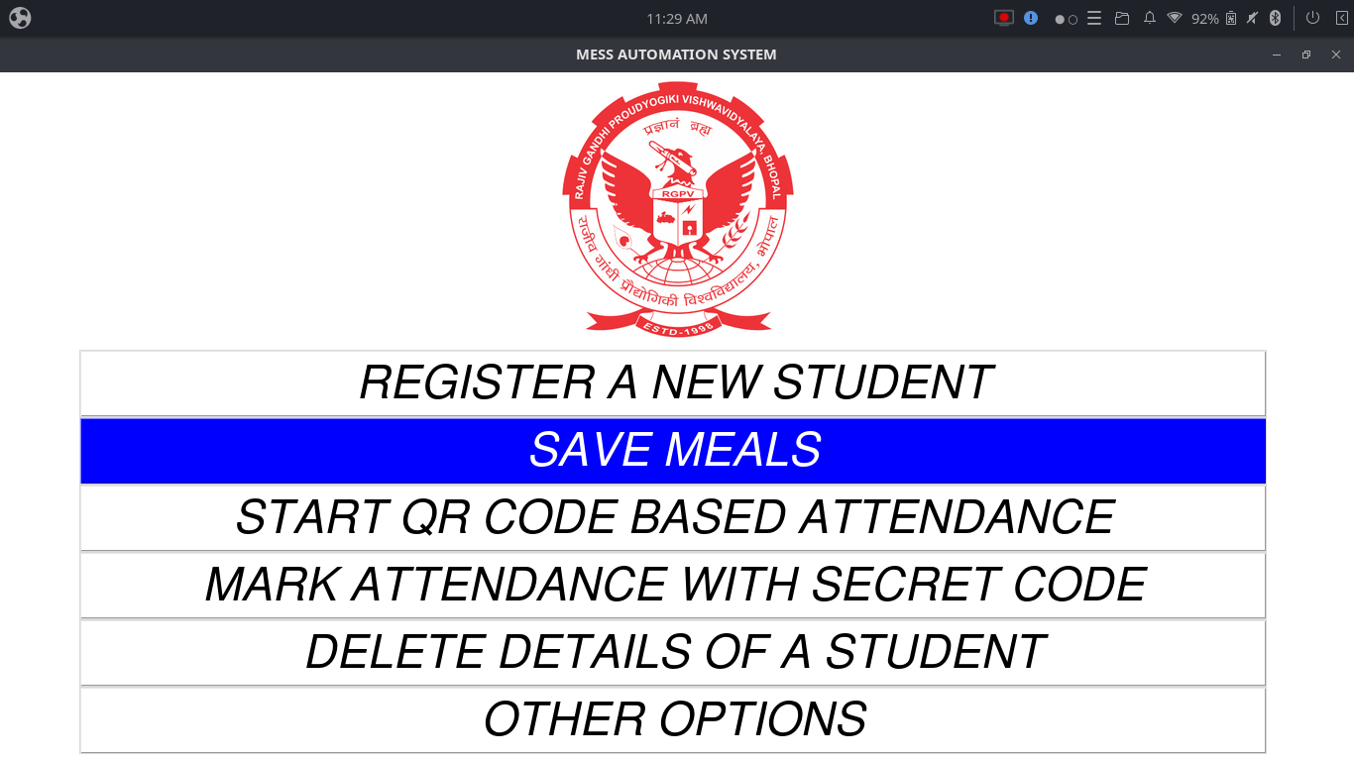

Slide 15
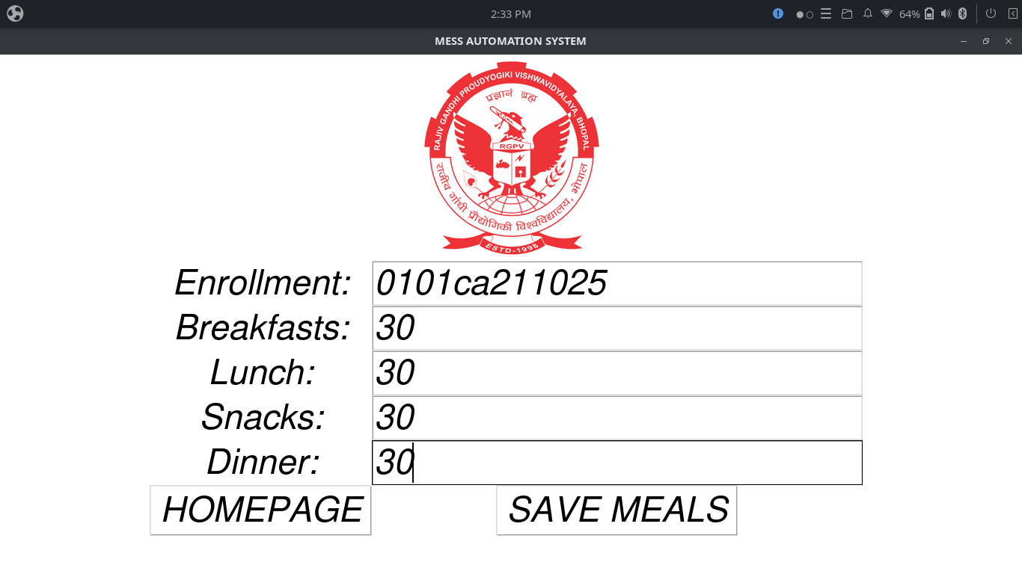

Slide 16
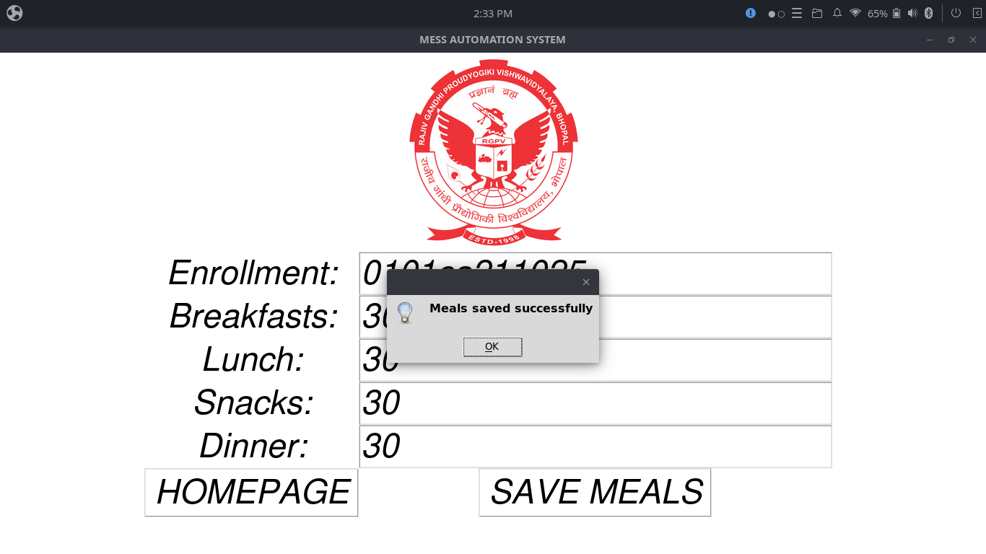

Slide 17
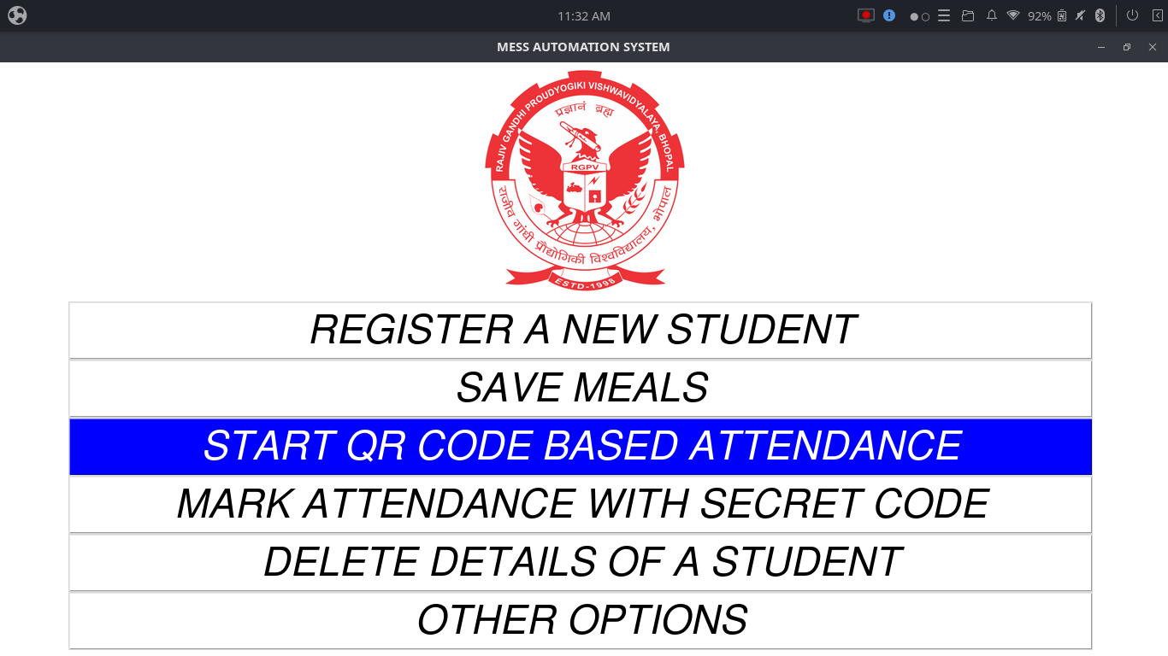

Slide 18
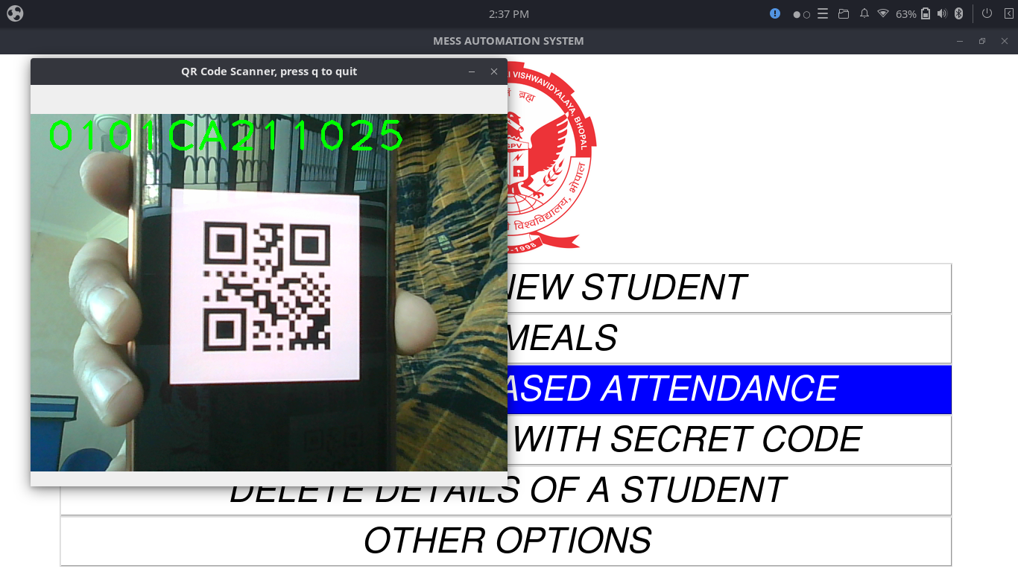

Slide 19
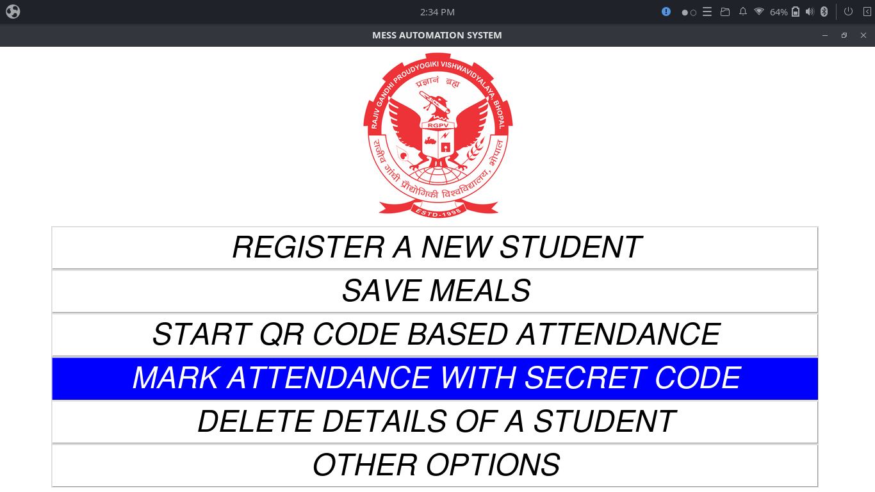

Slide 20
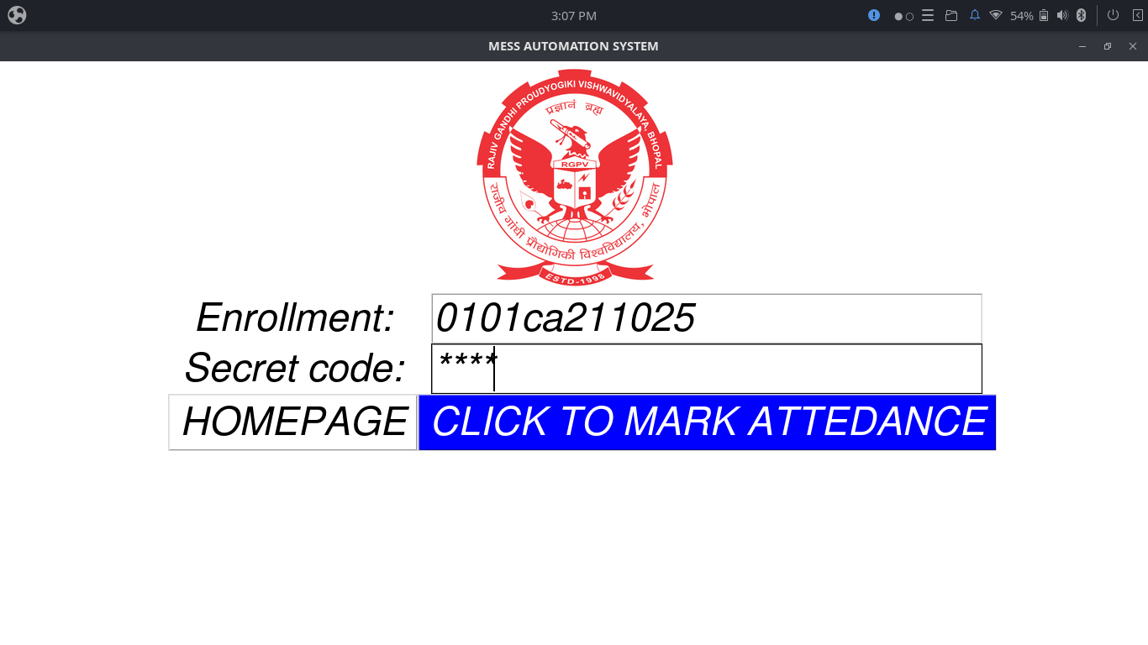

Slide 21
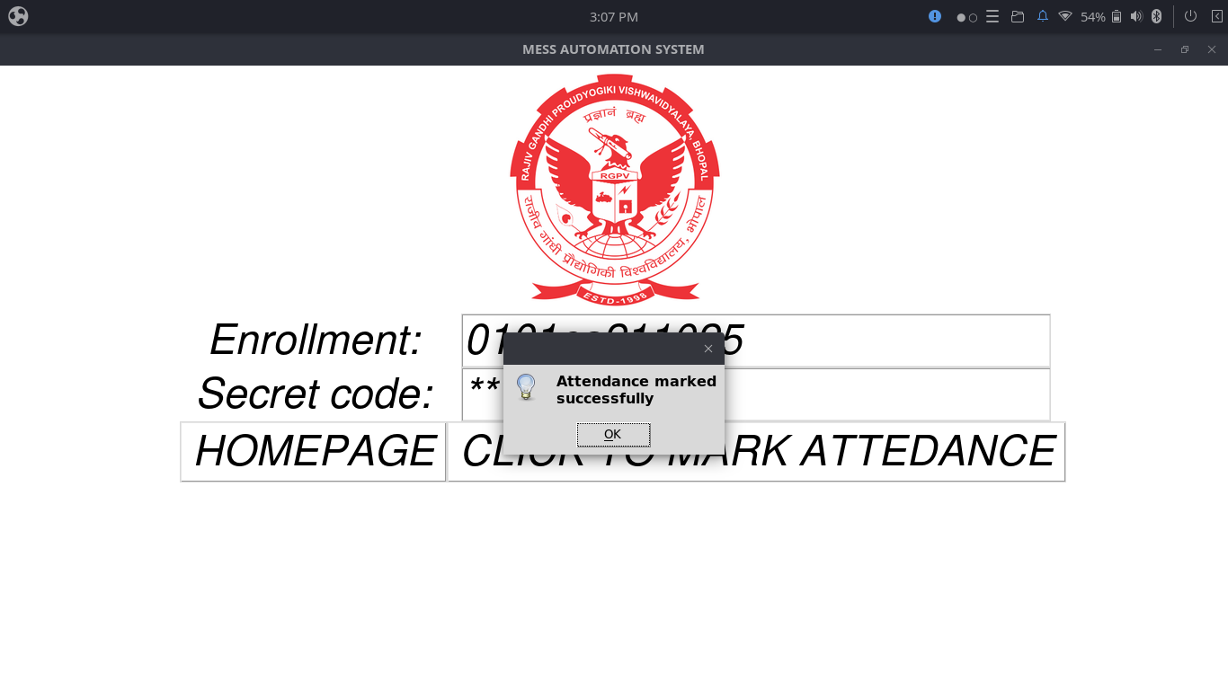

Slide 22
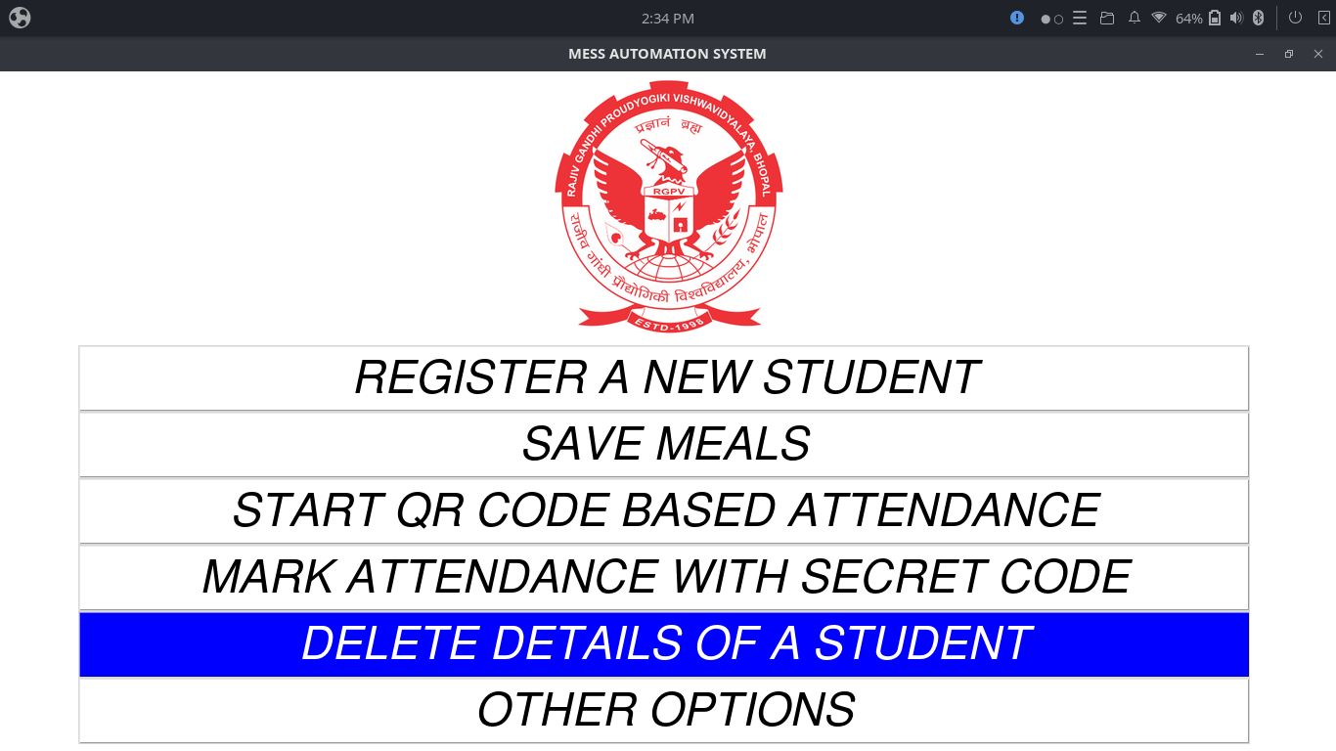

Slide 23
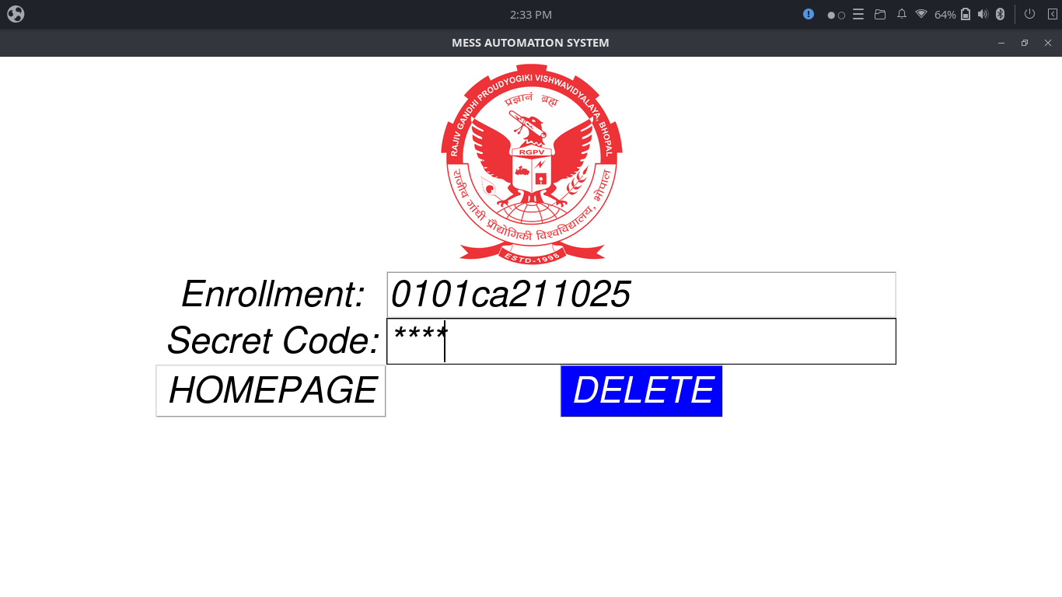

Slide 24
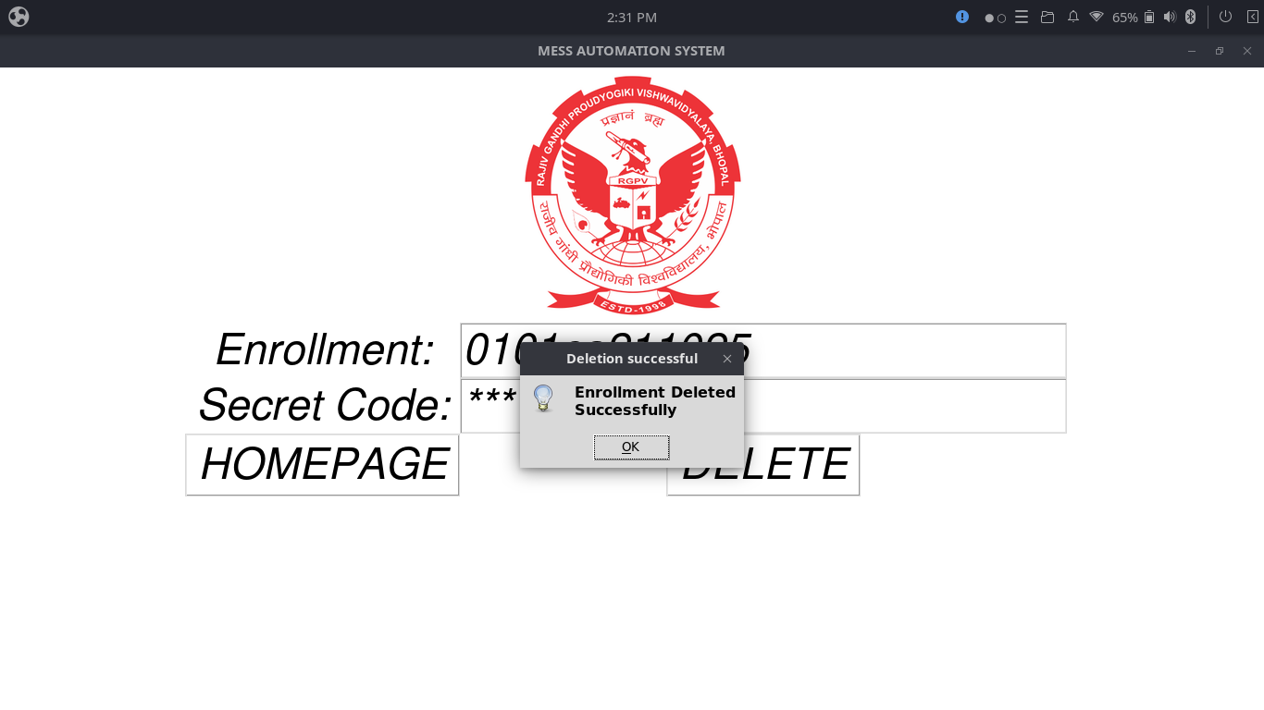

Slide 25
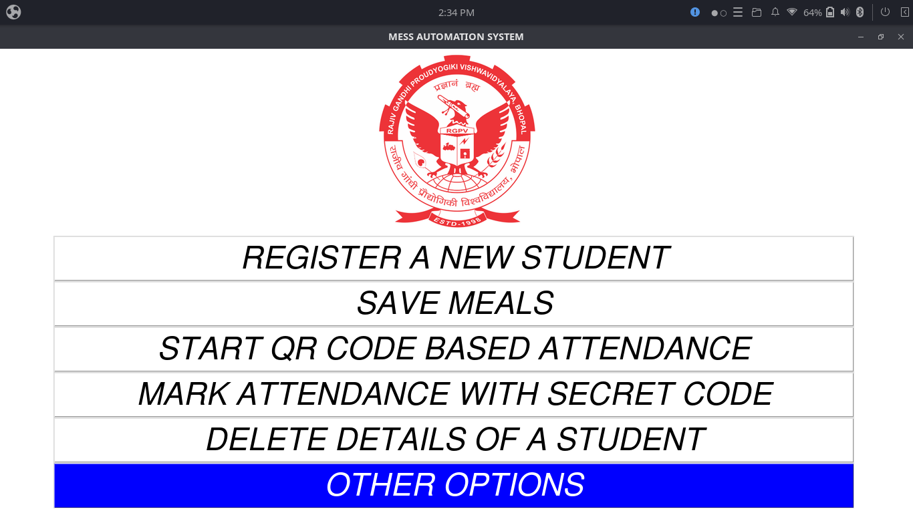

Slide 26
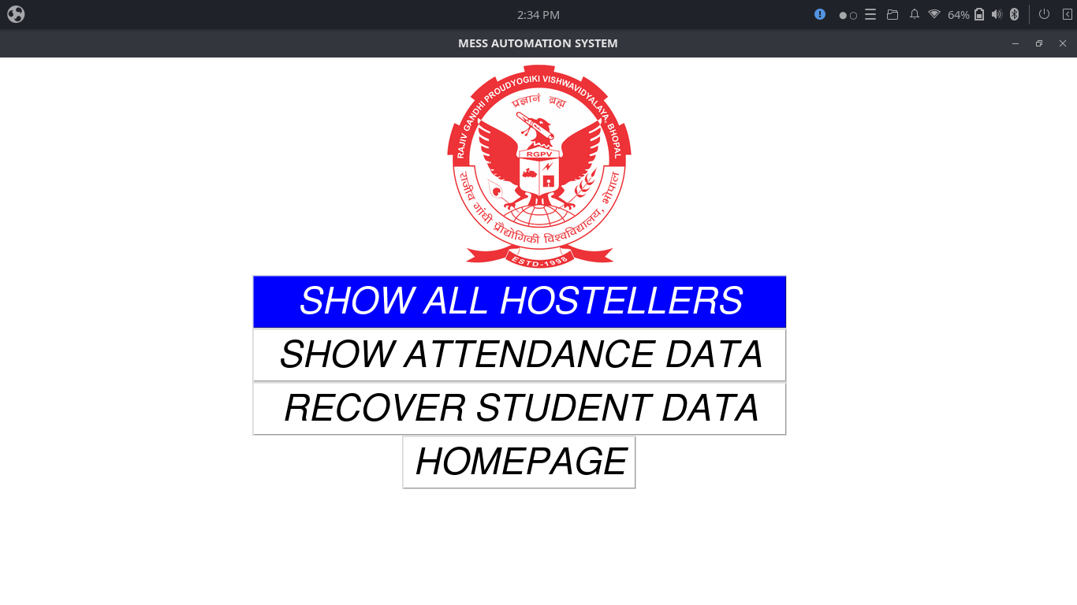

Slide 27
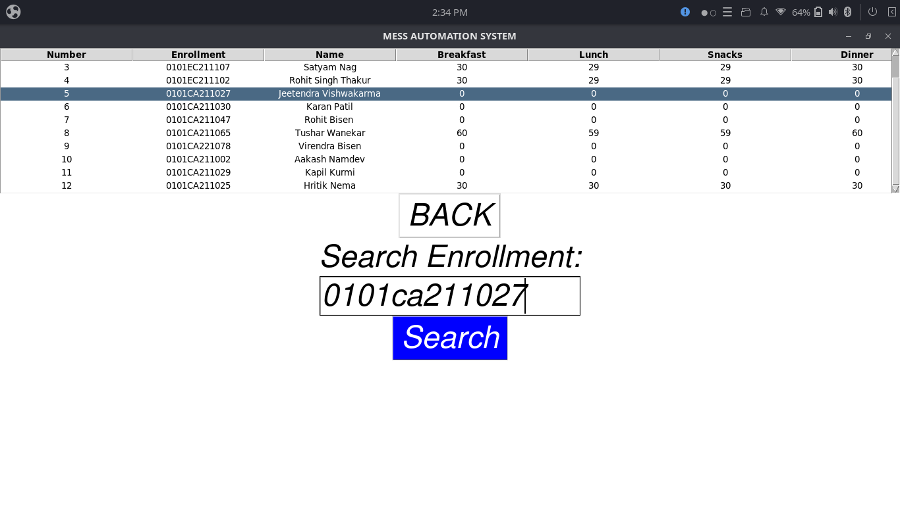

Slide 28
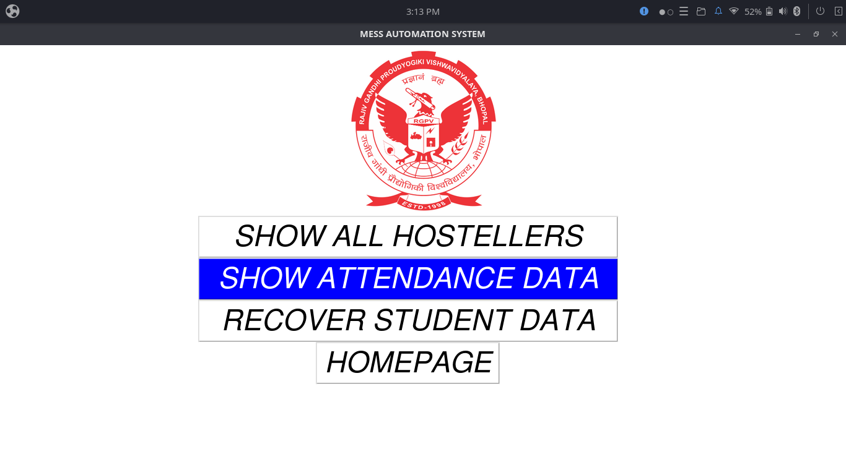

Slide 29
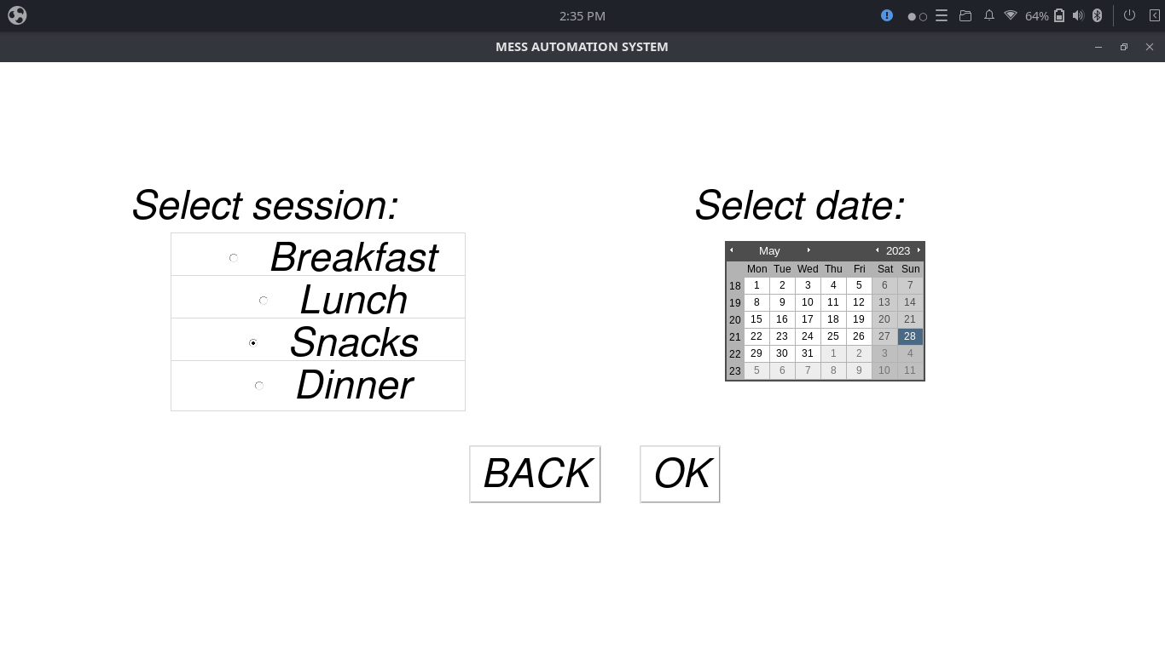

Slide 30
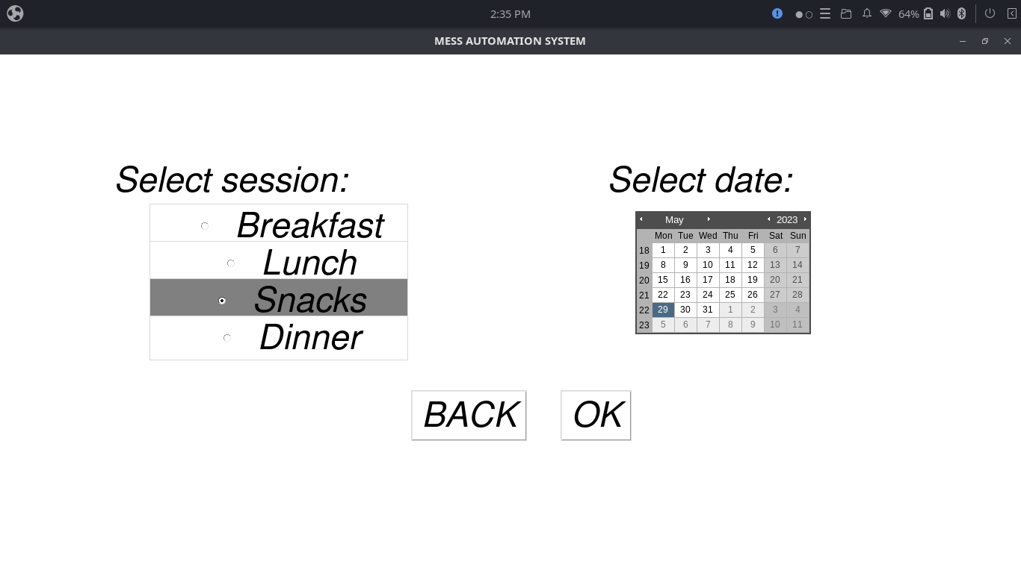

Slide 31
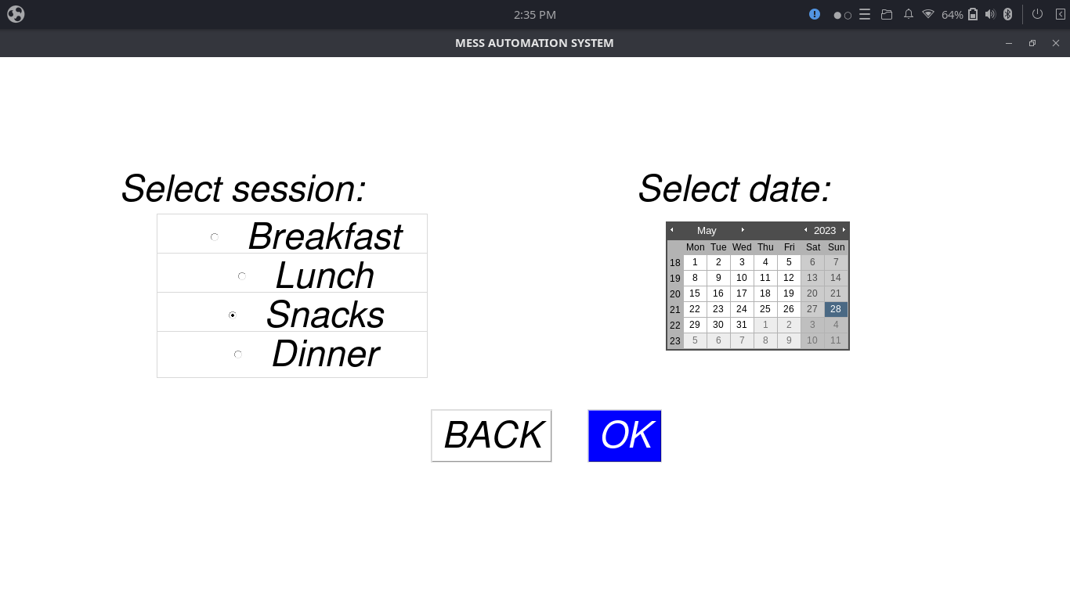

Slide 32
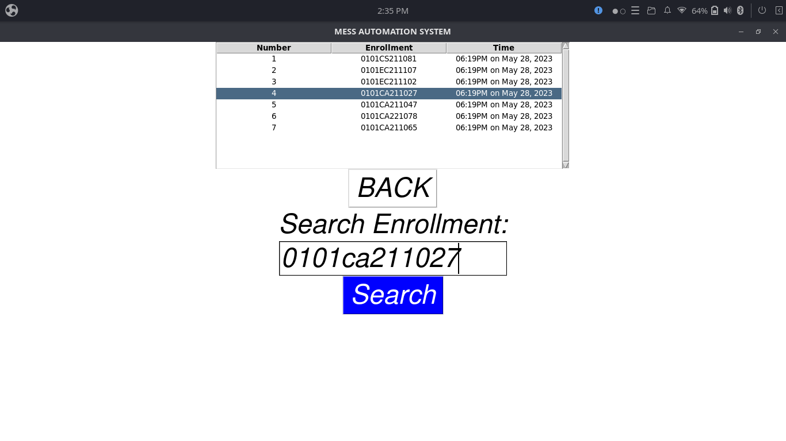

Slide 33
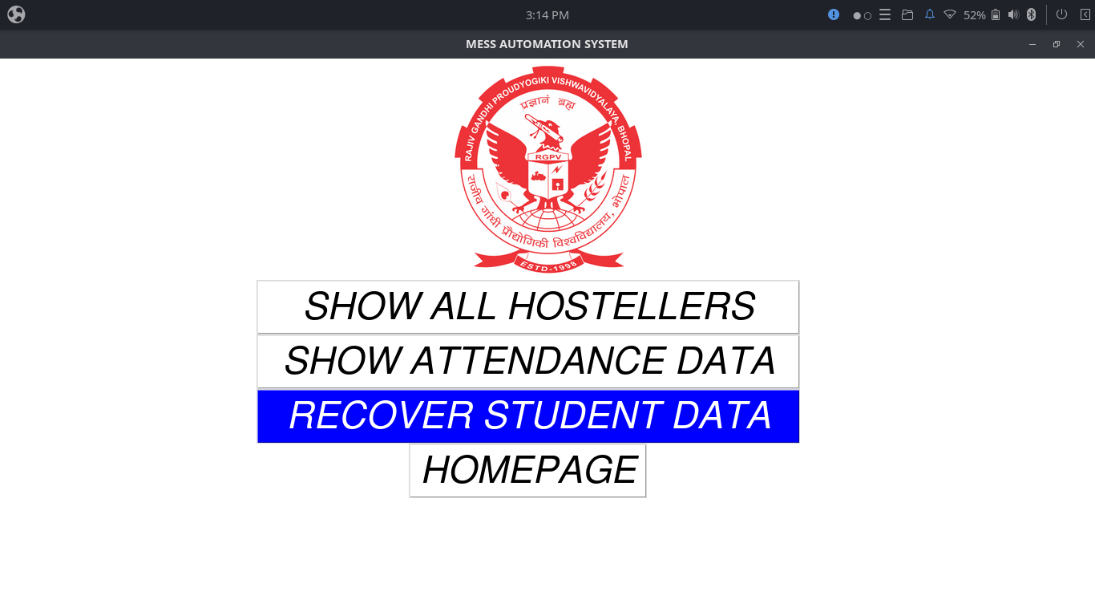

Slide 34
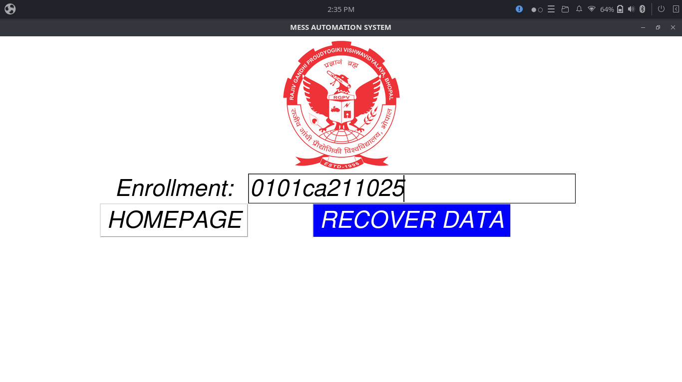

Slide 35
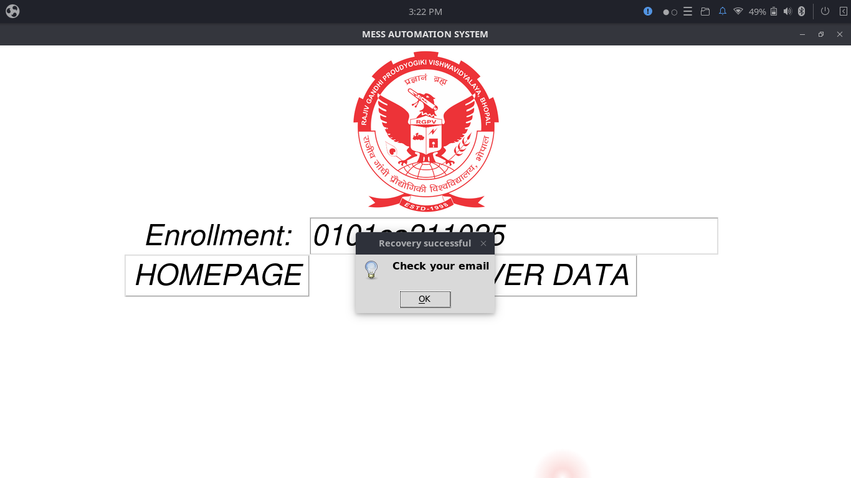

Slide 36
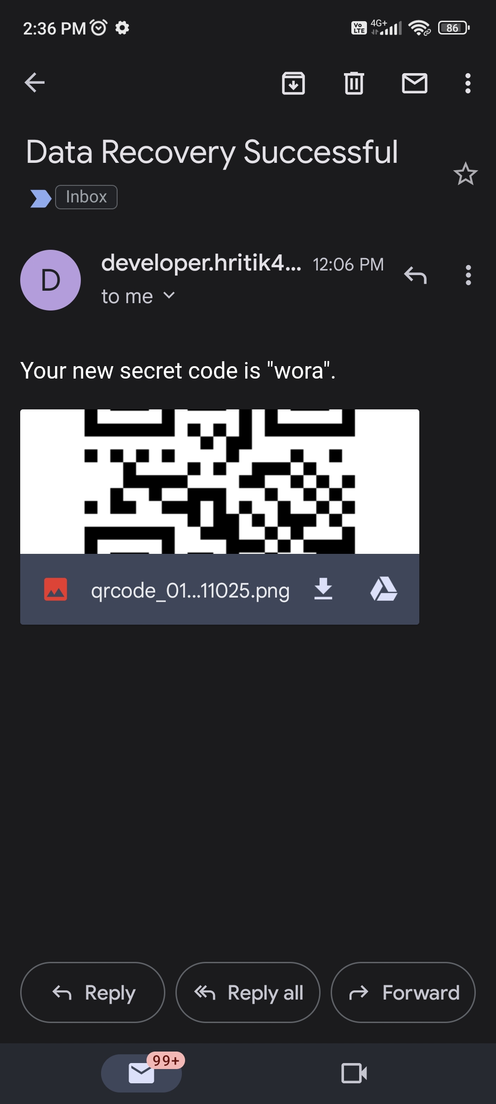

Slide 37
Technical Description

Slide 38
Technologies Used-
Programming Launguage – Python3
Operating System – Ubuntu Budgie 22.04.02 LTS
CPU – intel i3 7th generation

Slide 39
Python modules used
GUI – tkinter
Database – sqlite3
QR Code – qrcode & pyzbar
Camera – opencv
Communication – smtplib
Multitasking – threading
Hashing – hashlib(sha256)

Slide 40
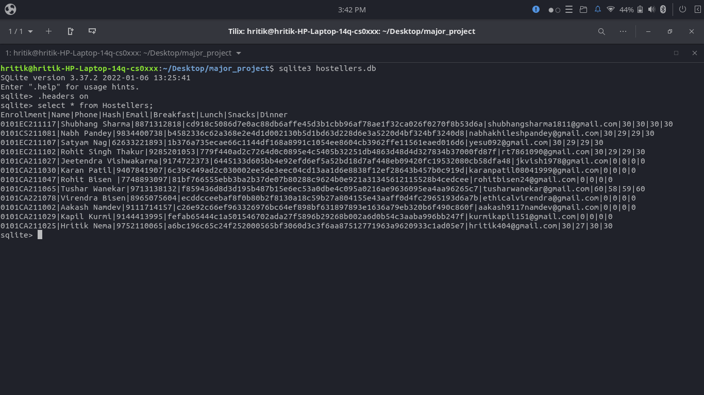

Slide 41
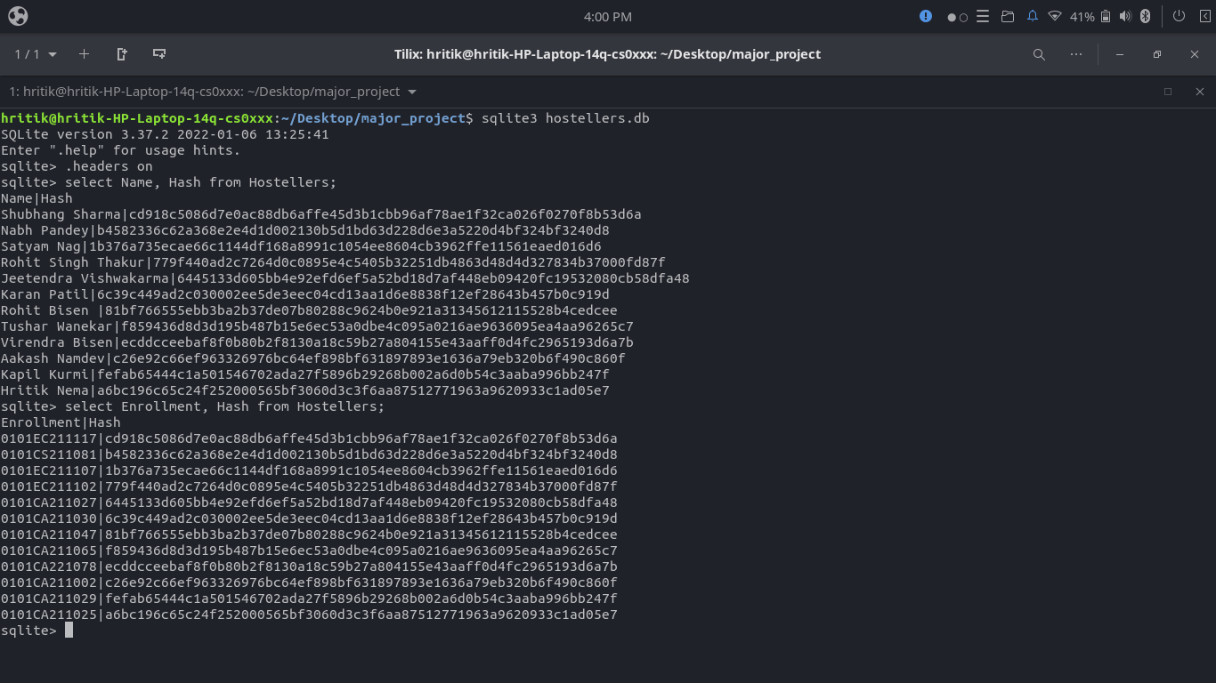

Slide 42
E-R Diagram
Enrollment
Name
Phone
Hash
Email
Breakfast
Lunch
Hostellers
Snacks
Dinner
Enrollment
Marks
datetime
Attendance

Slide 43
Limitations & Future Scope

Slide 44
Conclusion

Slide 45
Thank you

